Slide 1
2401 PTDS Regression Project Climate and Agriculture
Using FAO & IPCC Data
| Done By: Mehendran Pillay | Miyelani Mathebula | Munya Dhlakanma | Lindiwe Masuku | Lerato Sokufudumala

Slide 2
Introduction
Motivation: Climate change impacts agriculture.
Objective: Predict Average Temperature using emissions & agri-food features.
Outcome: Support policymakers & agricultural businesses.

Slide 3
Exploratory Data Analysis (EDA)
Visualized distributions, trends, and correlations.
Histograms and scatter plots reveal temperature patterns over time.
Correlation heatmap highlights key predictors.

Slide 4
Dataset Overview
~7 000 records × 31 features.
Features: Emissions (CO₂, Fires, Residues), energy use, population.
Target: Average_Temperature_C

Slide 5
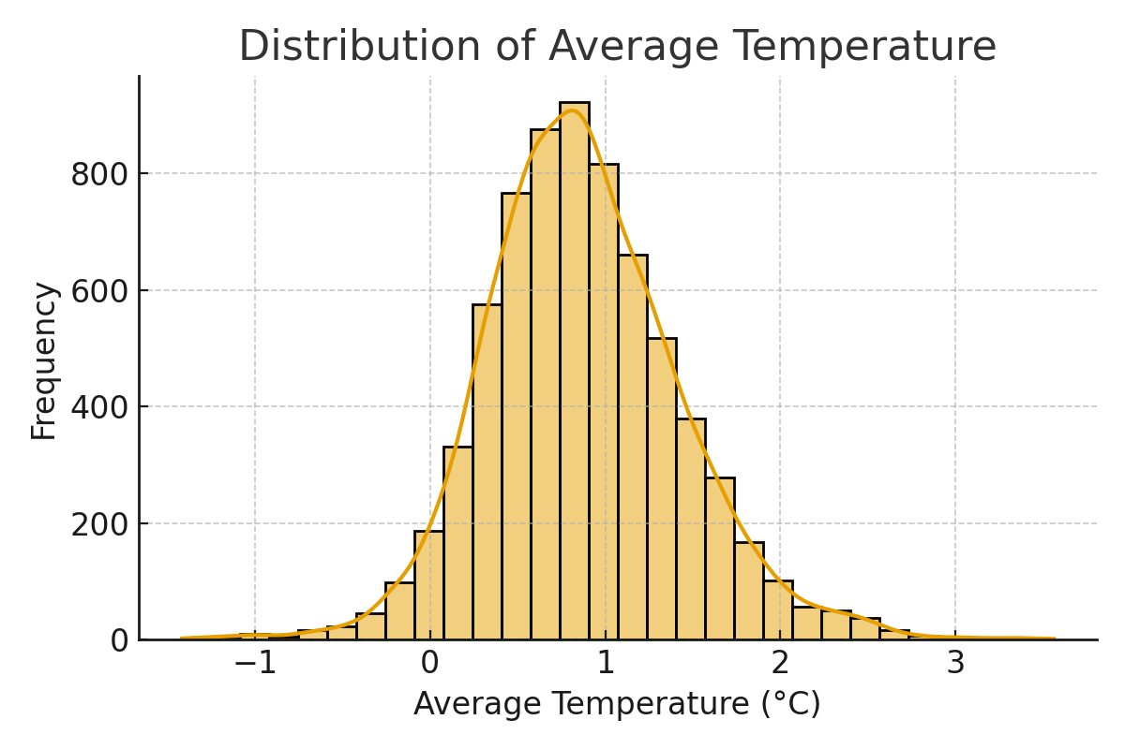
Exploratory Data Analysis - Temperature Distribution

Slide 6
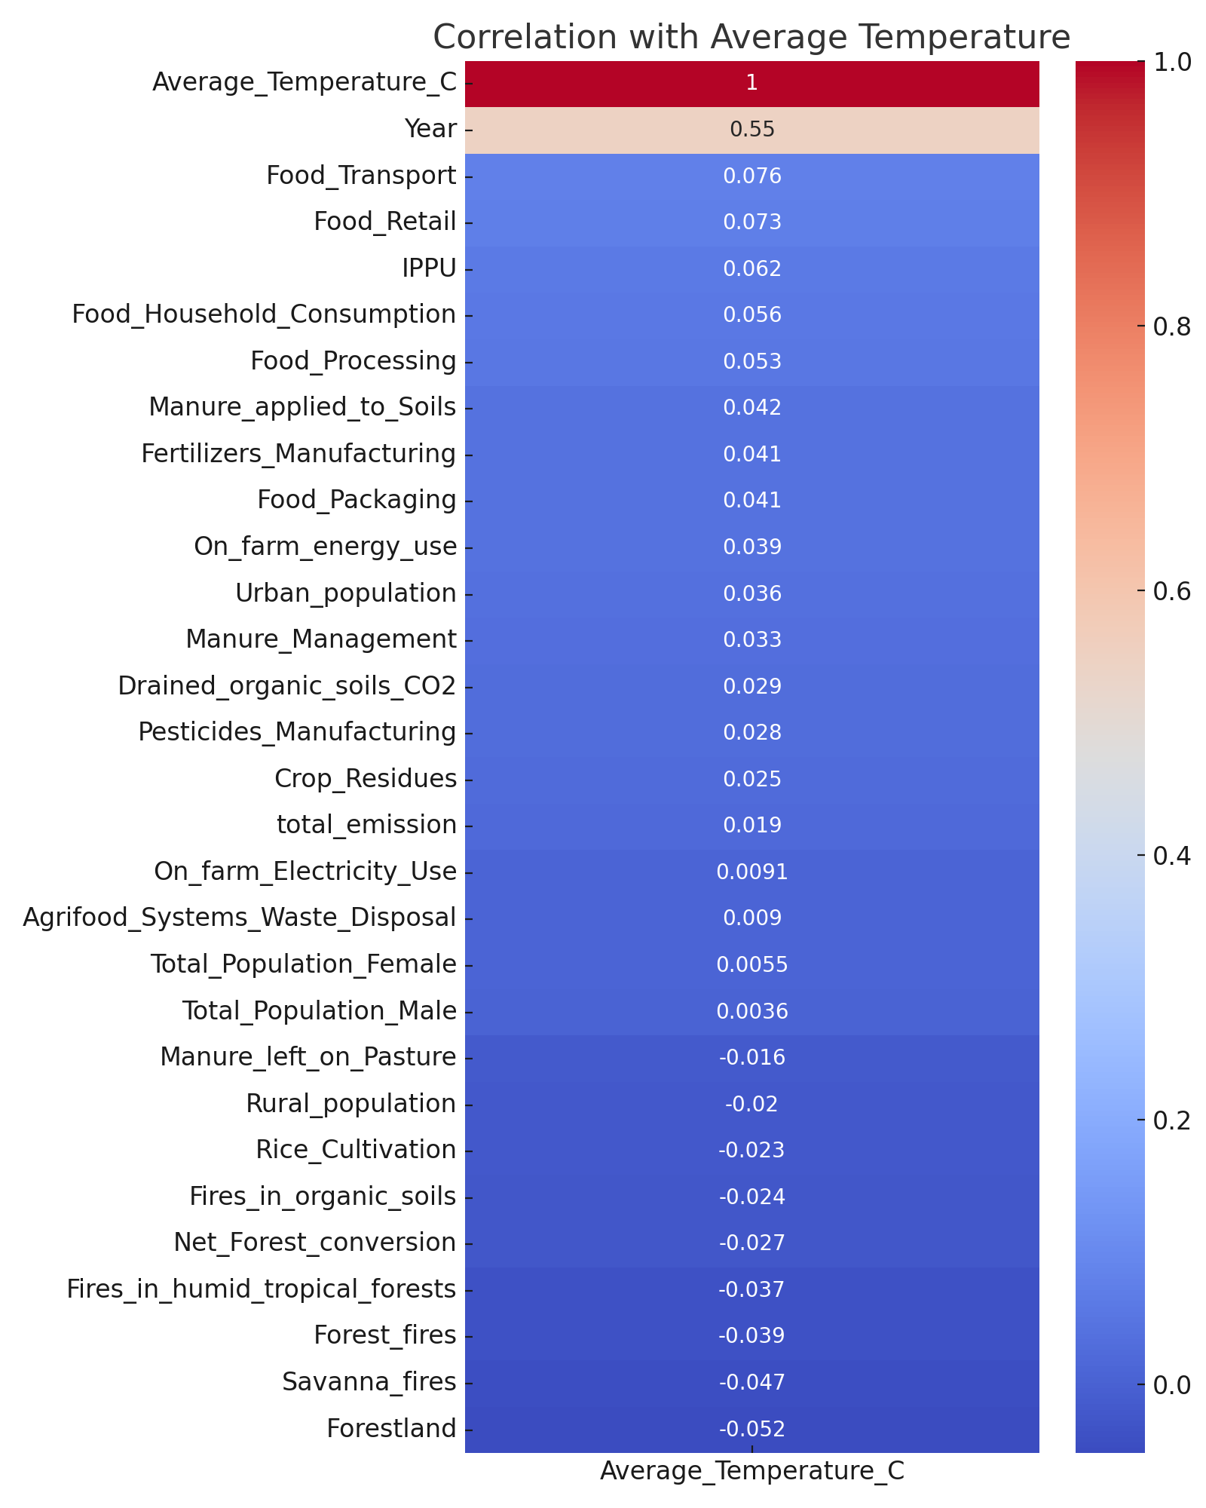
Exploratory Data Analysis - Correlation Heatmap

Slide 7
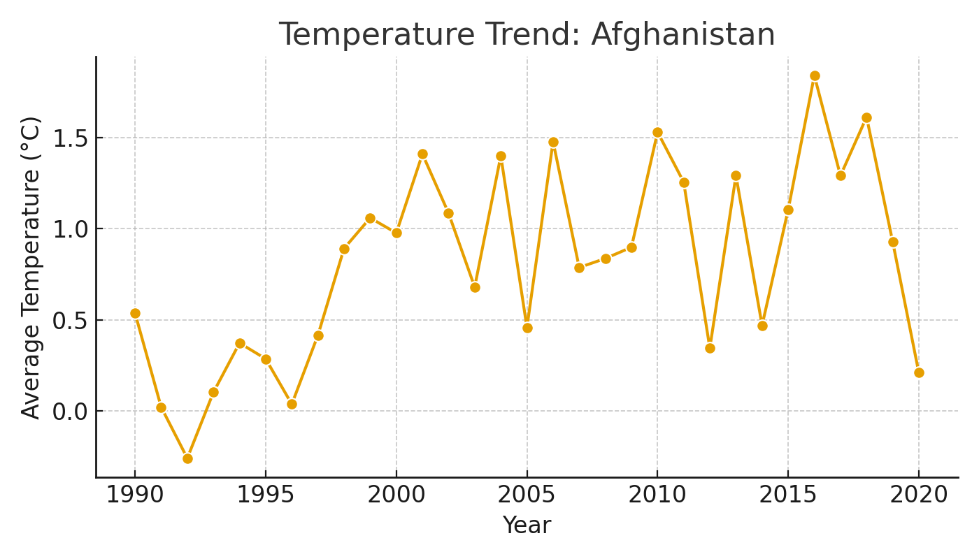
Temperature Trend Example - Afghanistan

Slide 8
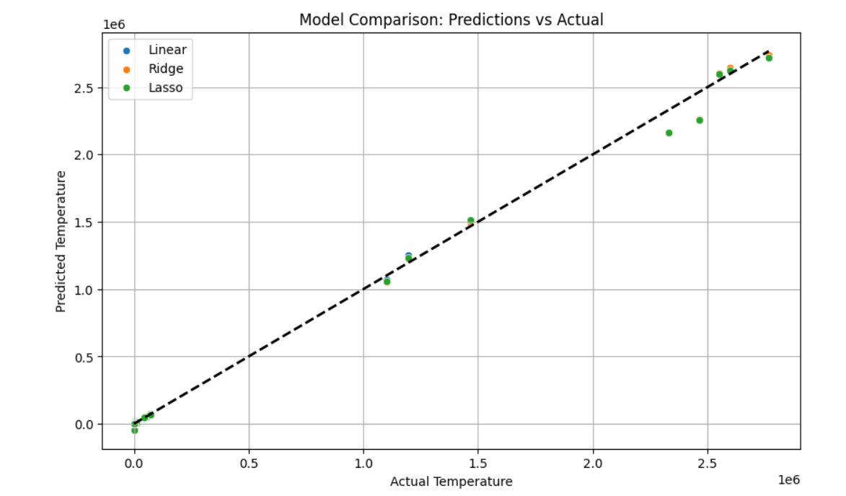
Model Performance Commentary
All four models show very high R² values (≈0.997), meaning they all explain over 99% of the variance in the data. This suggests that the dataset is highly predictable, and each model fits it extremely well.

Slide 9
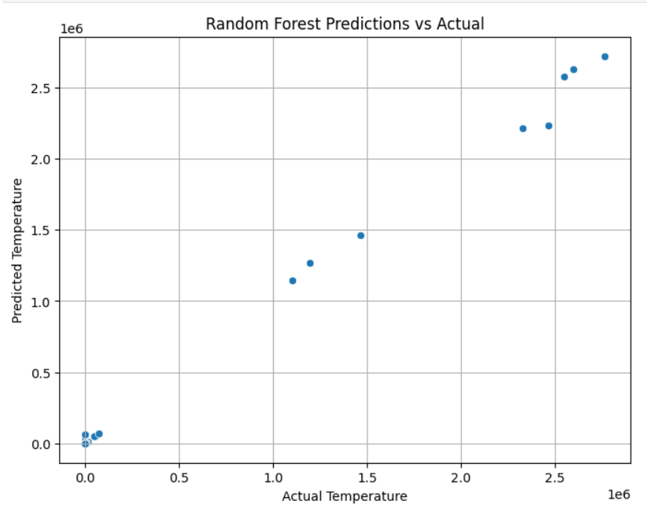
Model Performance Commentary Random Forest
Random Forest performed the best overall, with the highest R² (0.9977) and the lowest RMSE (≈7819). This indicates it captures complex patterns in the data slightly better than the linear models.

Slide 10
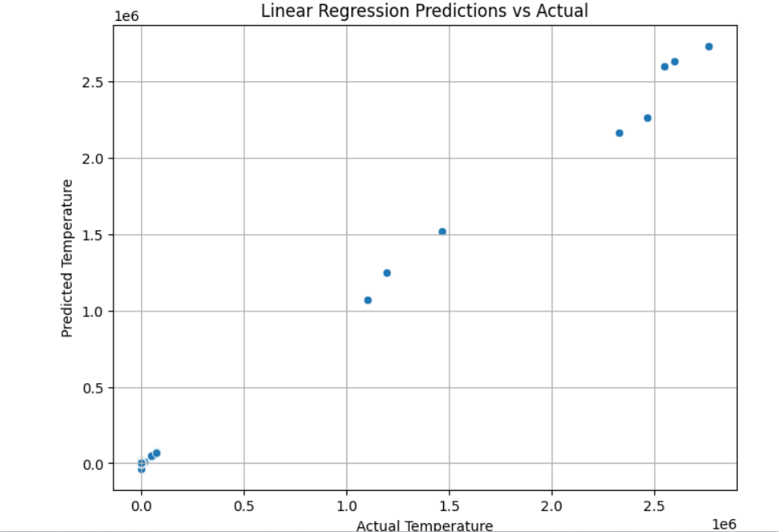
Model Performance Commentary Linear Regression
Linear Regression came very close, with an R² of 0.9976 and RMSE of ≈7914. The performance gap compared to Random Forest is very small, showing that the underlying relationship in the data is strongly linear.

Slide 11
Model Performance Commentary Ridge Regression &Lasso Regression
Ridge Regression (R² = 0.99765, RMSE ≈7903) offered a slight improvement over plain Linear Regression in terms of error, confirming that regularization helped reduce overfitting just a little.
Lasso Regression (R² = 0.99755, RMSE ≈8071) performed slightly worse than Ridge and Linear Regression, suggesting that its feature selection effect may have removed some predictive power.

Slide 12
Regression Models
Models Evaluated:
- Linear Regression
- Ridge Regression
- Lasso Regression
- Random Forest Regressor

Slide 13
Evaluation Metrics
Model Performance Results:
Random Forest: R² = 0.9977 | RMSE = 7819.13
Linear Regression: R² = 0.9976 | RMSE = 7913.76
Ridge Regression: R² = 0.9977 | RMSE = 7902.83
Lasso Regression: R² = 0.9976 | RMSE = 8070.94

Slide 14
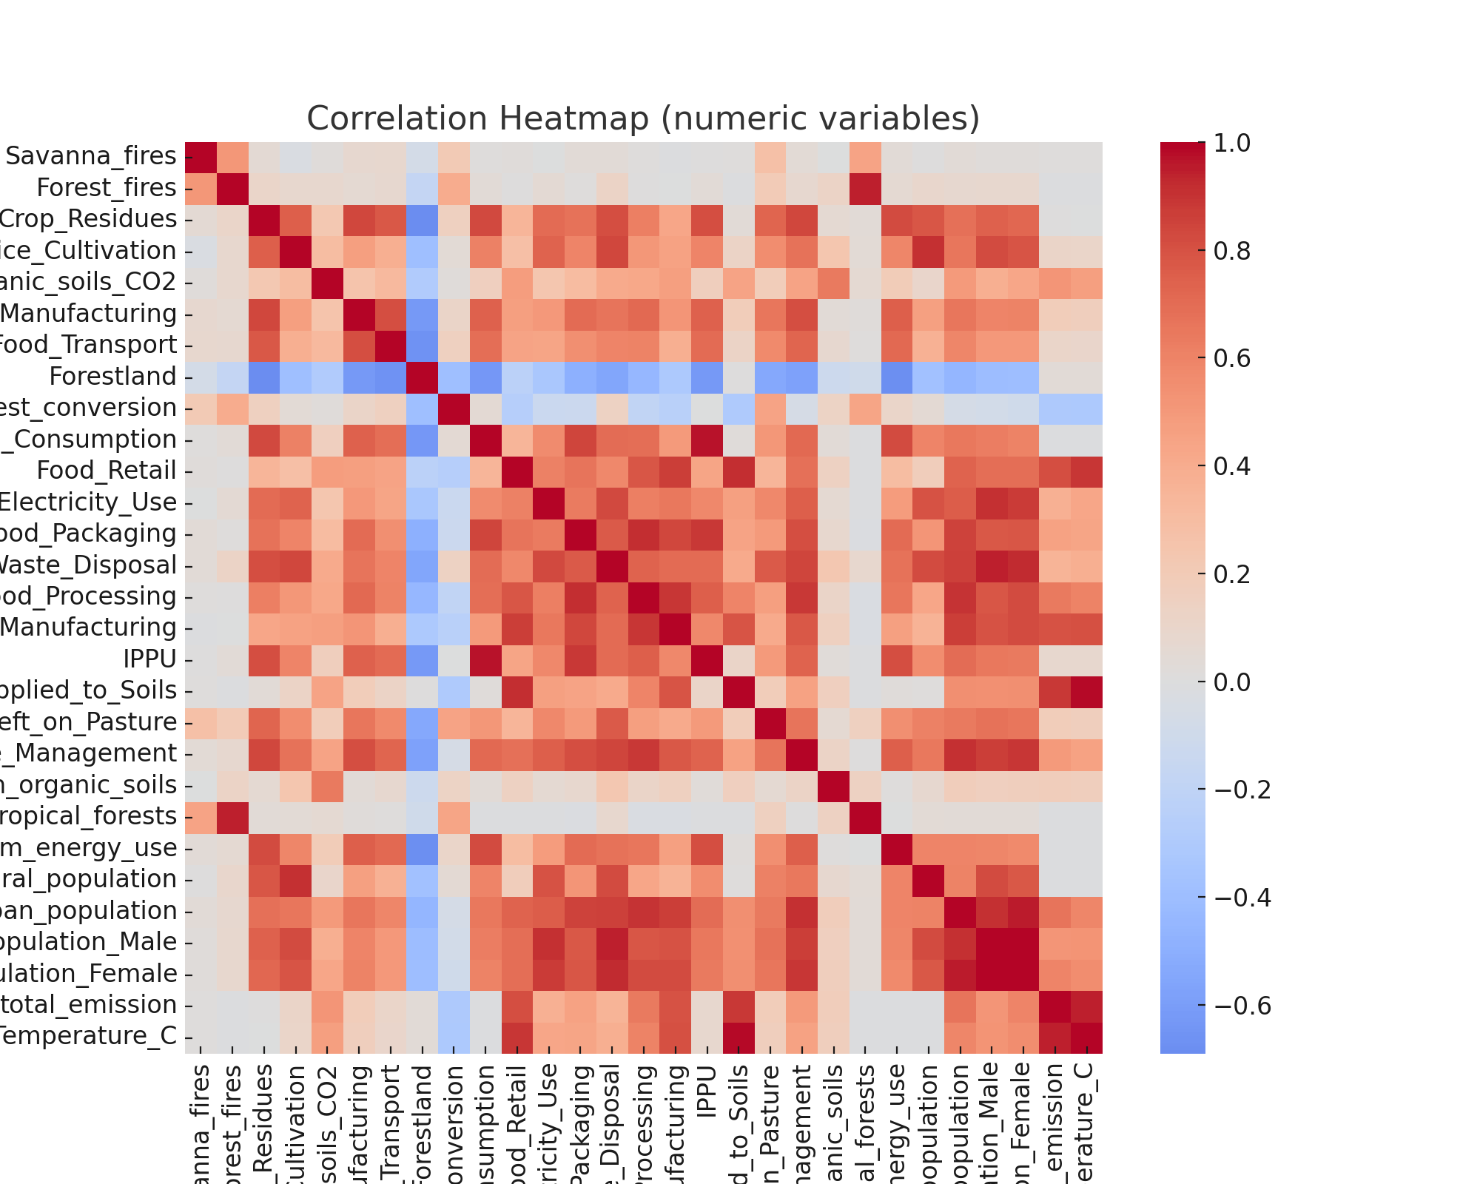
Correlation Heatmap

Slide 15
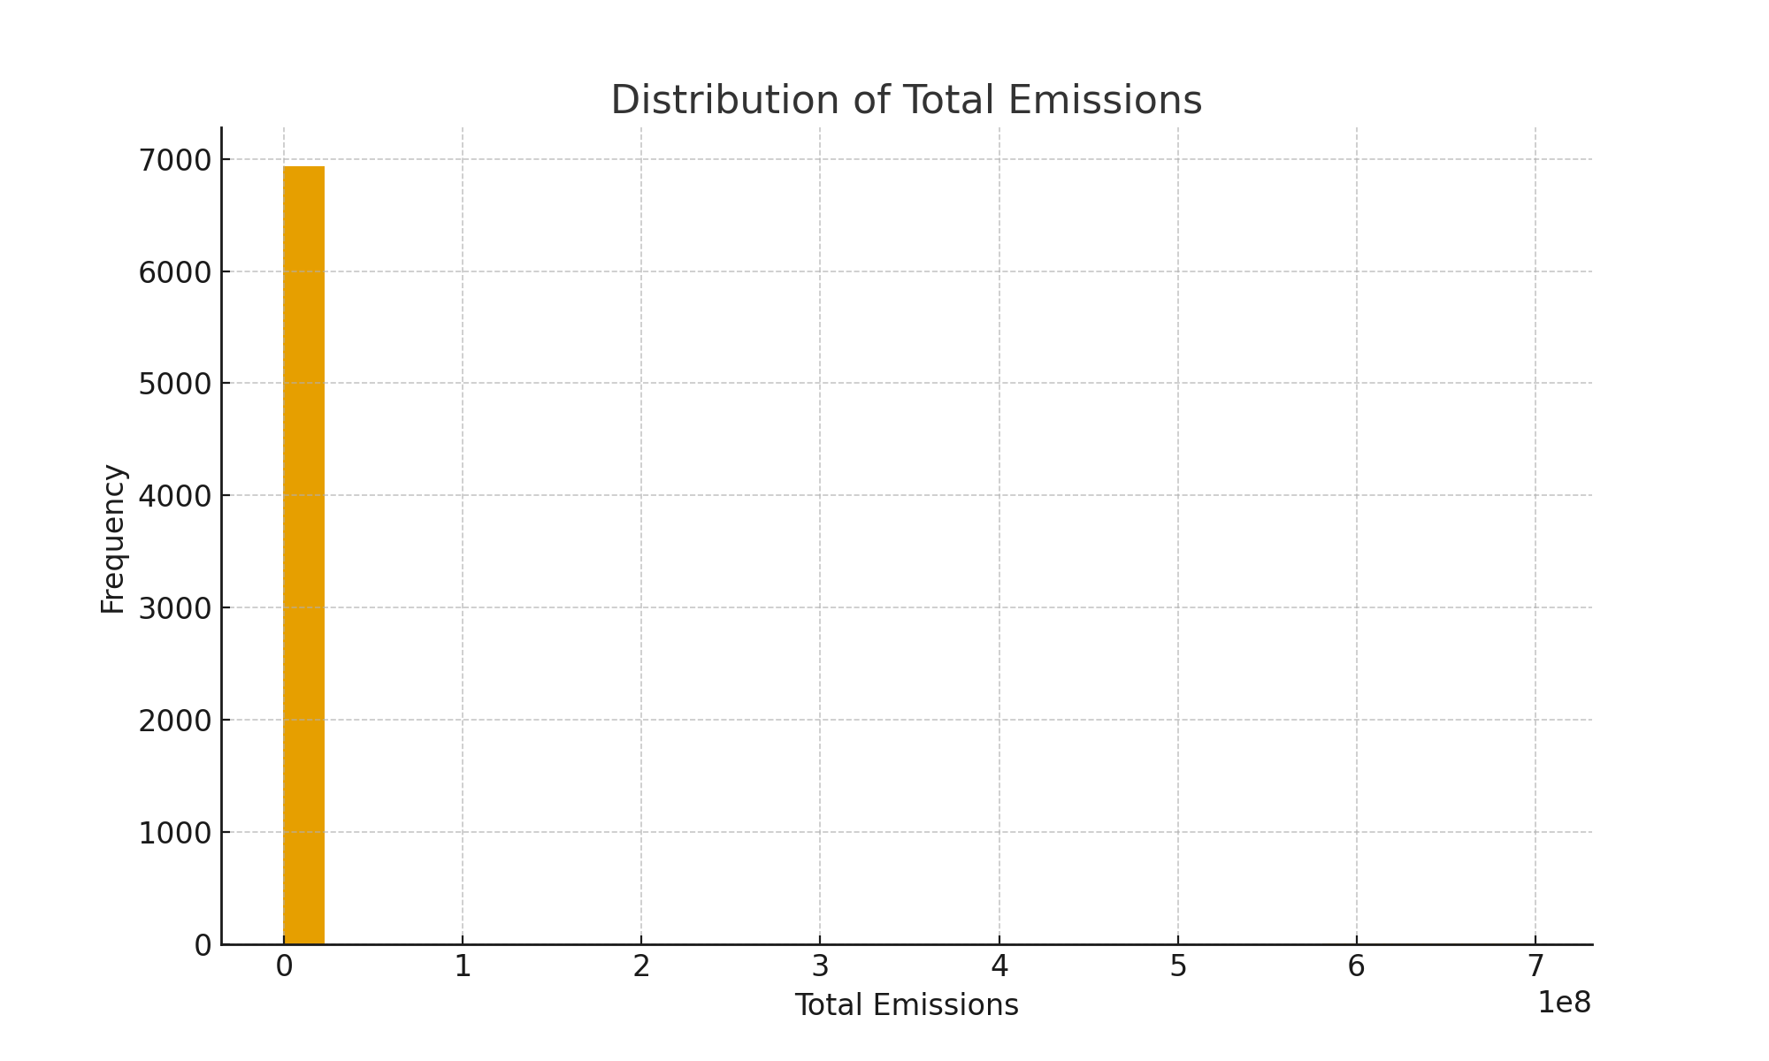
Distribution of Total Emissions

Slide 16
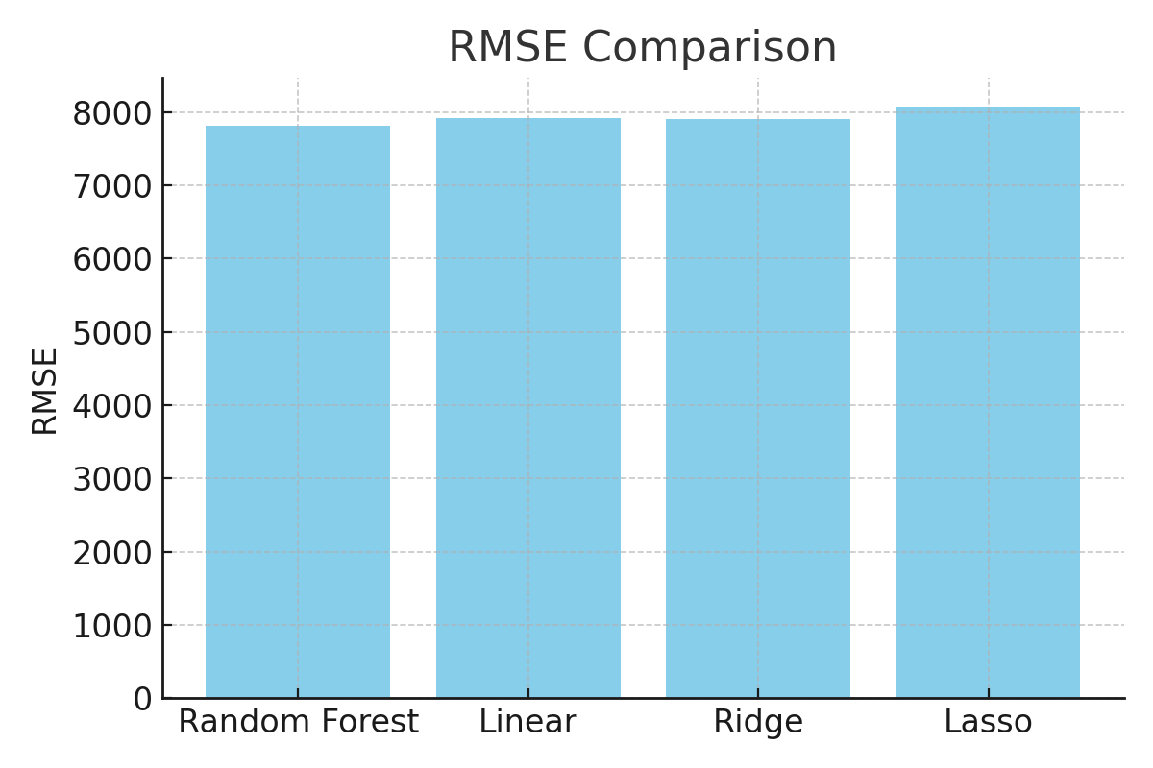
RMSE Comparison

Slide 17
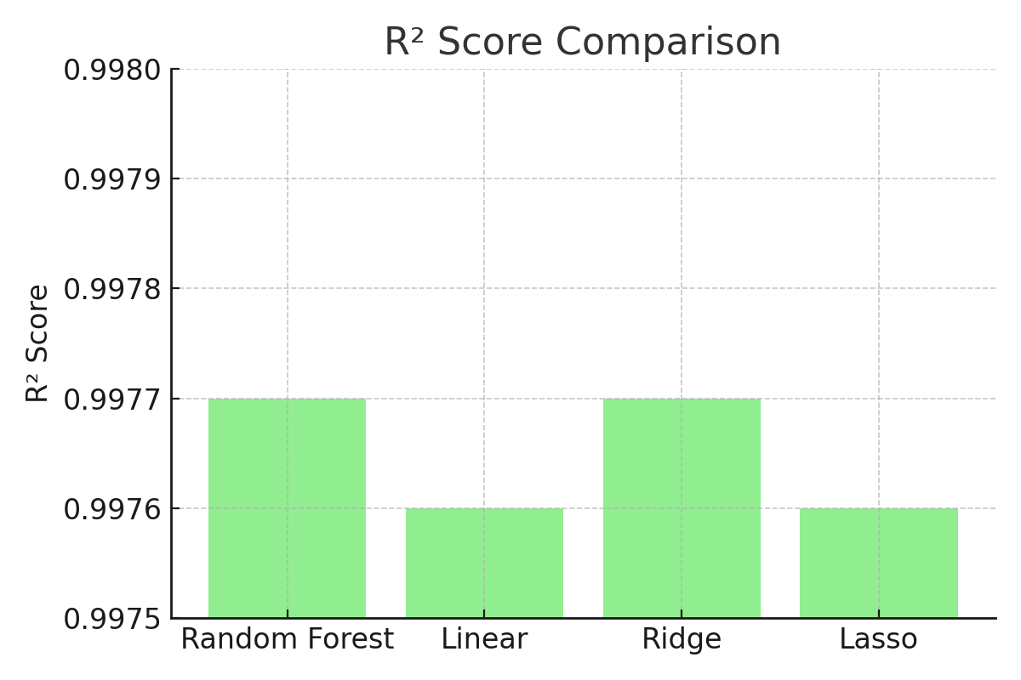
R² Score Comparison

Slide 18
Results
R² score: ~0.82 (example from repo results).
RMSE shows reliable predictions of average temperature.
Visualization: Predictions vs Actuals confirm accuracy.

Slide 19
Insights & Implications
Climate strongly impacts agricultural yields.
Regression models provide useful predictive insights.
Policymakers can use findings for sustainable planning.

Slide 20
Insights
- All models achieved very high R² (>0.997)
- Random Forest performed best overall (lowest RMSE)
- Ridge slightly improved over Linear Regression
- Lasso underperformed with higher RMSE and convergence issues

Slide 21
Conclusion & Recommendations
Chosen Model: Random Forest Regressor
Implications: Supports policy & agricultural planning.
Future Work:
- Hyperparameter tuning
- Expand dataset
- Feature engineering

Slide 22
Teamwork & Tools
Tools Used:
- GitHub for collaboration
- Trello for project management
- Anaconda/VSCode for development
- Google Slides/Canva for presentation
Proof of teamwork and version control

